Slide 1

Voice - Enabled Navigator Platform for Data Professionals
Ansh Rathod 22107022
Ayush Sharma 22107028
Atharva Thube 22107062
Balkrishna Yadav 22107060
Project Guide
Ms. Harsha Zope

Slide 2
Outline
Introduction
Literature Survey of the existing systems
Limitations of the existing systems
Problem statement
System Design
Technologies and methodologies
Implementation
Conclusion
References

Slide 3
Introduction
In the fast-evolving world of data, data professionals require continuous skill enhancement and personalized career guidance.
Individuals starting or advancing their careers in Data profession, often face several key challenges:
  Navigating the Job Market
  Understanding Salary Expectations
  Continuous Skill Enhancement
While there are platforms recommending jobs, courses and predicting salaries but, these solutions often operate in fragments.

Slide 4
Introduction
To address these challenges, we propose the “Voice - Enabled Navigator Platform for Data Professionals” specifically designed for data professionals. This platform integrates various features to provide:
Personalized job recommendations
Accurate salary predictions
Skill-enhancing course recommendations.
Voice-based interface for hands-free interaction.

Slide 5
Motivation
For a data professional it is important to constantly upgrade their skills and find new job opportunities to stay competitive:
However, it is difficult to navigate through various job recommendation, salary prediction, and course platforms, as they are often separate or fragmented.
There are no domain specific platforms.
Hence, professionals are forced to use multiple platforms which makes the process time-consuming and less efficient.
This challenge inspired us to create a single, unified platform designed specifically for data professionals, offering all features in one place.

Slide 6
Objectives
To predict salaries for Data Professionals using gradient boosting algorithm.
To recommend job opportunities based on content-based filtering / collaborative filtering.
To recommend relevant courses for skill improvement using content-based filtering / collaborative filtering.
To develop a voice-Assisted Interface to take input from the user using NLP.
Users can share their feedback & by analyzing this feedback, system will display this feedback to new users to enhance their decision-making process and overall user experience using php.

Slide 7
Literature Survey of the existing system
"Enhanced AI Voice Assistance using Machine Learning and NLP" focuses on developing a voice assistant that utilizes ML and natural language processing (NLP) to perform tasks through voice commands.(IEEE)
Authors: J Gowthamy, A Senthilselvi, Aniket Kumar, Aakash S, Gandikota Sreedhar.
Technologies Used:
  Natural Language Processing (NLP): speech-to-text, context understanding,
  APIs: OpenAI for conversational understanding, News API, Weather API
  Speech Recognition: Converts voice commands into text using Python libraries.
  Python: Used for integrating ML models and APIs.
Methodologies Used: Intent Recognition, API Integration and Contextual Responses.
Inspired by this approach we have built a voice enabled navigator platform which can predict salary and recommend jobs and courses using ML algorithms and NLP.

Slide 8
Literature Survey of the existing system
"SALARY PREDICTION USING MACHINE LEARNING“ proposes a salary prediction model utilizing Linear Regression, based on features like experience, job type, and education.(IJASRET)
Authors: D. M. Lothe, Prakash Tiwari, Nikhil Patil, Sanjana Patil, Vishwajeet Patil.
Technologies Used:
  Algorithm used: Linear Regression.
  Model Evaluation: Mean Squared Error (MSE)
  Back End: Python, Scikit-learn, NumPy/Pandas, Flask.
  Front End: Html, Css, Javascript.
Methodologies Used: Data Collection & cleaning, Model Selection, Training & Evaluation, Comparison.
Inspired by this approach, we developed a salary prediction system that leverages Gradient Boosting instead of Linear Regression to enhance prediction accuracy.

Slide 9
Literature Survey of the existing system
"JOB RECOMMENDATION SYSTEM USING MACHINE LEARNING" presents an Android application to recommend IT jobs based on user skills and preferences. (IEEE2023)
Authors: Sakshi Gadegaonkar, Abhijeet Salunke, Darsh Lakhwani, Sahil Marwaha.
Technologies Used:
  Android Development: Kotlin, Jetpack Compose, Material 3 Design Principles
  Back End: Ktor (Kotlin framework), MongoDB, FastAPI (Python)
  Machine Learning Model: Python, Jupyter Notebooks
  Algorithm Used: Content-Based Filtering.
Methodologies Used: Data Collection & Cleaning, Feature Extraction, Model Building, UI/UX Design, Backend Integration, Testing & Evaluation
Inspired by this approach, we developed an advanced job recommendation system that incorporates collaborative filtering to enhance the personalization of job matches.

Slide 10
Limitations of existing systems
Existing systems that recommend jobs, courses, and predict salaries have certain limitations, including:
Fragmentation: The systems for job recommendations, salary predictions, and course suggestions operate independently, requiring users to navigate through multiple platforms.
Voice Navigation: The existing solutions do not use voice assistants, which makes them less accessible to use for an individual who prefer hands-free interactions.
Domain-specific platform: There is no specialized system designed to recommend or predict the job, course or salary of a particular profession.

Slide 11
Problem statement
Problem statement:
Existing systems for recommending jobs, courses, and predicting salaries face significant limitations, including fragmentation, lack of voice navigation capabilities, and lack of domain-specific focus.
Solution:
Our goal is to address these issues by developing a unified, domain-specific platform that integrates job recommendations, salary predictions, and course suggestions, while incorporating voice navigation to enhance user experience and accessibility.

Slide 12
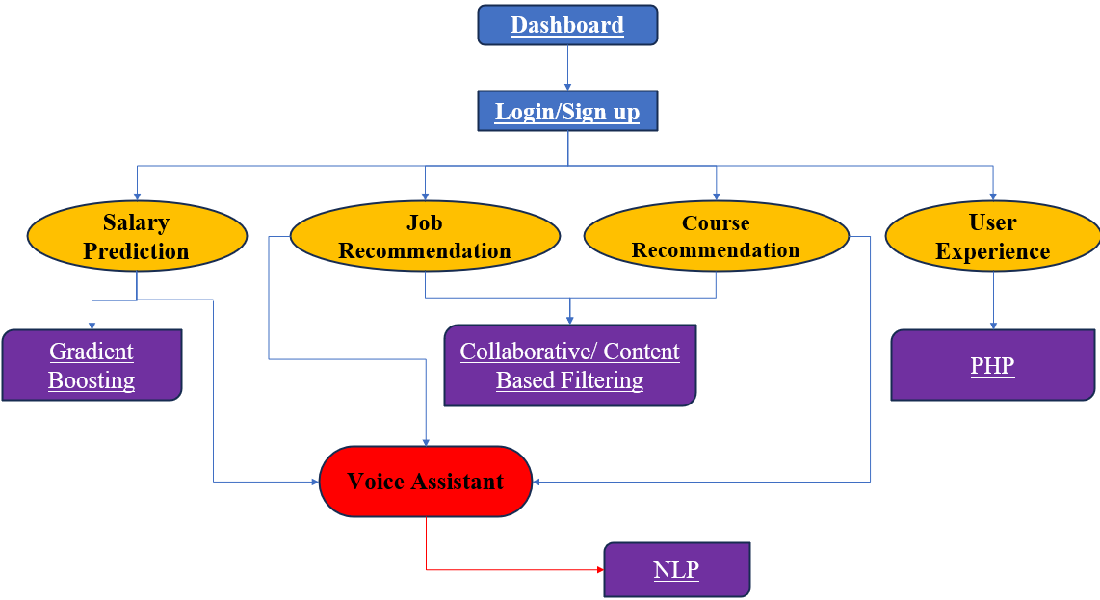
System Design

Slide 13
Technologies and methodologies
Algorithm:
  Gradient Boosting.
  Content-based/Collaborative Filtering.
Dataset:
  Datasets from Kaggle.
Web Technologies:
  Backend: Php, Apache 24.
  Frontend: HTML, CSS, JavaScript, Flask.

Slide 14
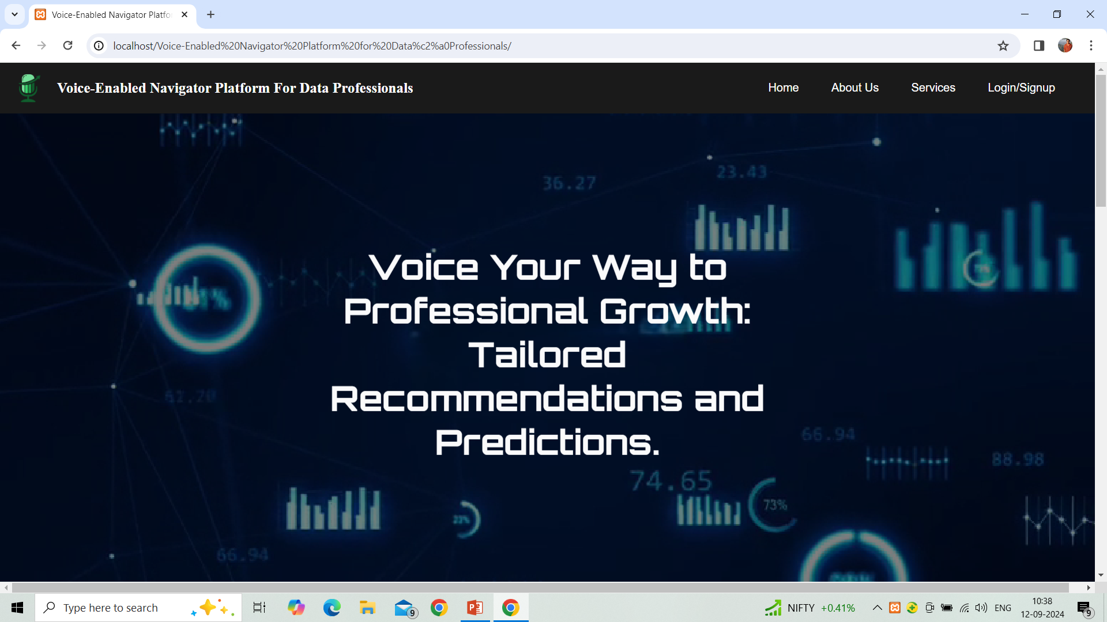
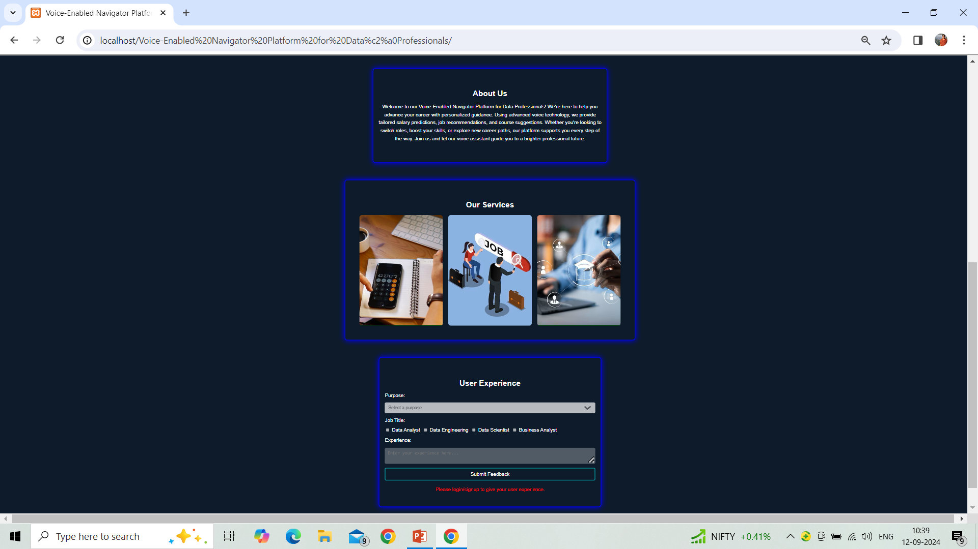
Implementation
Figure 1.1 Dashboard

Slide 15
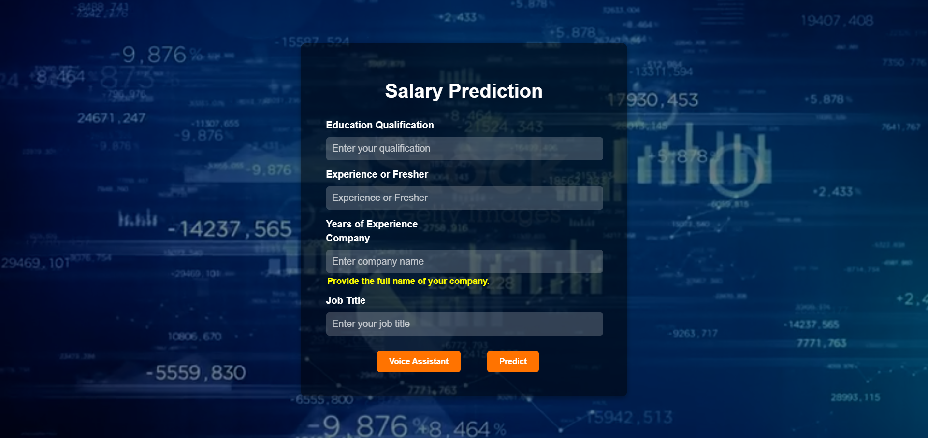
Implementation
Figure 1.2 Salary Prediction

Slide 16
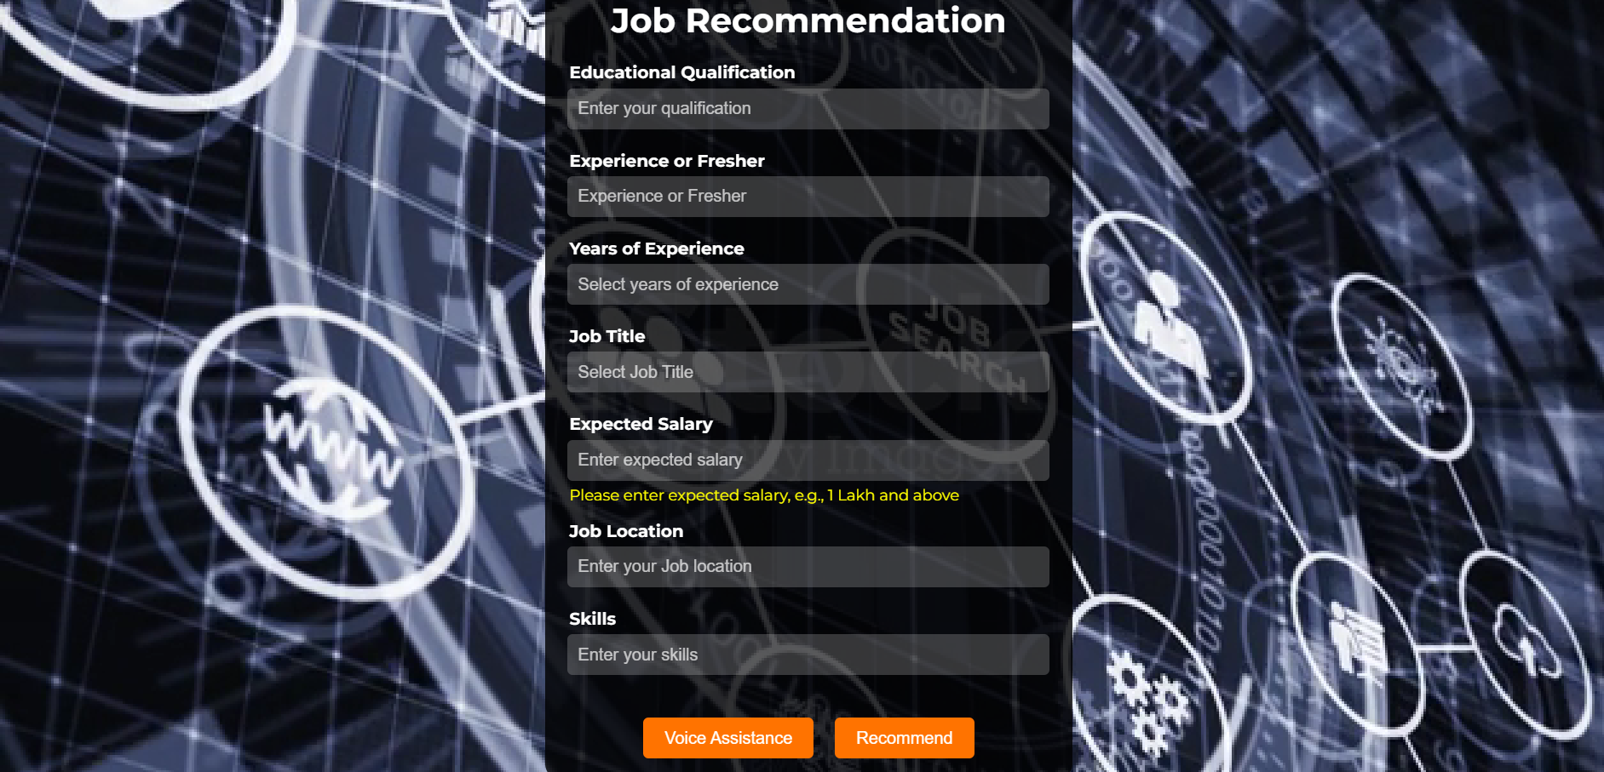
Implementation
Figure 1.3 Job Recommendation

Slide 17
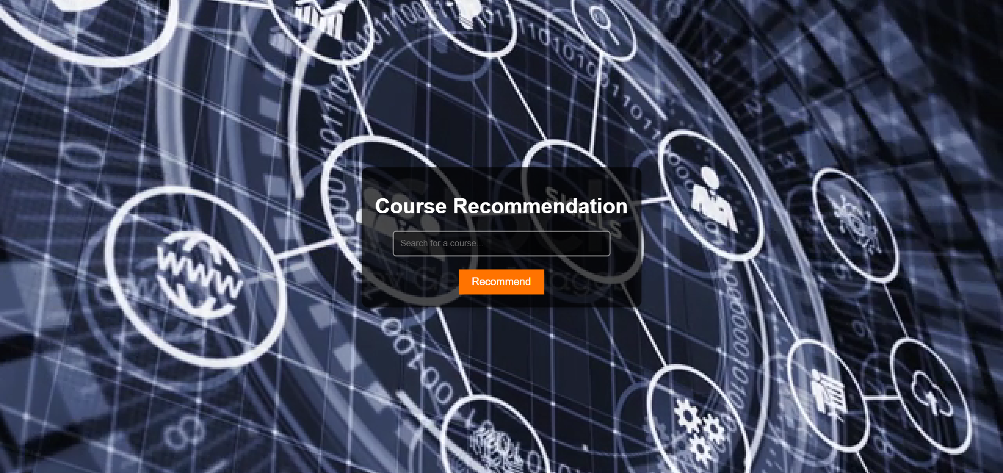
Implementation
Figure 1.4 Course Recommendation

Slide 18
Conclusion
The Voice-Enabled Navigator Platform for data professionals addresses the limitations of existing systems and provide a unified solution.
With its advanced voice navigation capabilities, the platform enhances accessibility and user experience, offering a streamlined approach to career guidance customized specifically for the data professionals.

Slide 19
References
[1] J. Gowthamy, A. Senthilselvi, A. Kumar, S. Aakash and G. Sreedhar, "Enhanced AI Voice Assistance using Machine Learning and NLP," 2023 Third International Conference on Smart Technologies, Communication and Robotics (STCR), Sathyamangalam, India, 2023, pp. 1-5, doi: 10.1109/STCR59085.2023.10396893.
[2] S. Gadegaonkar, D. Lakhwani, S. Marwaha and P. A. Salunke, "Job Recommendation System using Machine Learning," 2023 Third International Conference on Artificial Intelligence and Smart Energy (ICAIS), Coimbatore, India, 2023, pp. 596-603, doi: 10.1109/ICAIS56108.2023.10073757.

Slide 20
Thank You...!!

